Slide 1
BANDIT WARS
BBM 421 TERM PROJECT – FINAL UPDATE

Slide 2
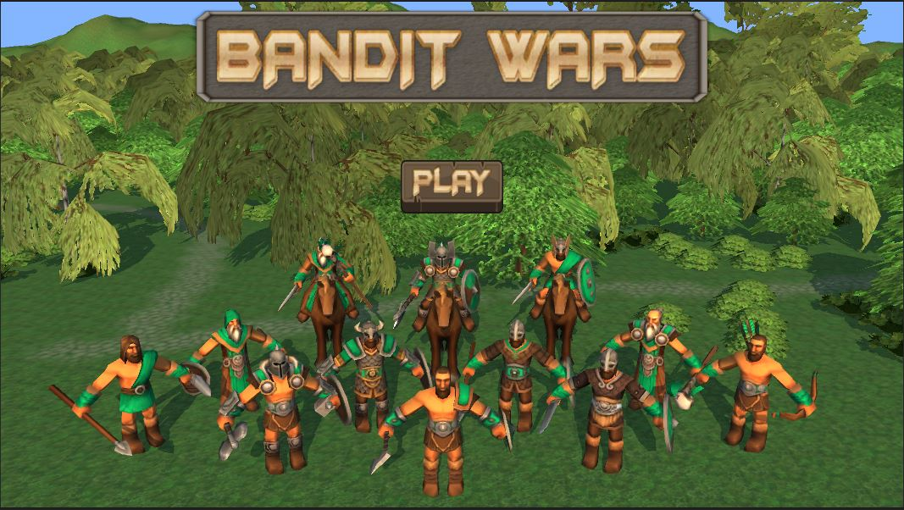
Main Menu

Slide 3
What is Bandit Wars ?
Bandit wars is 2 player turn based strategy game which focuses on group management and fast decision making.
Each player makes their adjustments with their units and then battle takes place.
The goal of the game is to kill the king of the opposite player.

Slide 4
What we have promissed, what we came up with ?
We have promissed to come up with a tile based strategy game.
Most challenging part was to balance the unit attributes and to adjust the strategy of the game.
Game is easy to play as we promissed but hard to come up with a good strategy.

Slide 5
What we have added since the last submit ?
Implemented combat system
Added full functionality to GUI
Made some additions to GUI
Now players can change unit colors
Added particle effects for combat
Redefined some unit attributes

Slide 6
Choosing Actions for Units
When clicked on a unit(or choosen from GUI), a menu appears which lets the user to select action types.
When clicked upon action types, tiles that in the possible movement or attack range will change color.(Default action is movement)
When user clicks upon one of these tiles, again this tile also will change color to indicate user made a selection to target this tile in the next turn.
If there are enemy units on the targeted tiles units will attack during their action phase.

Slide 7
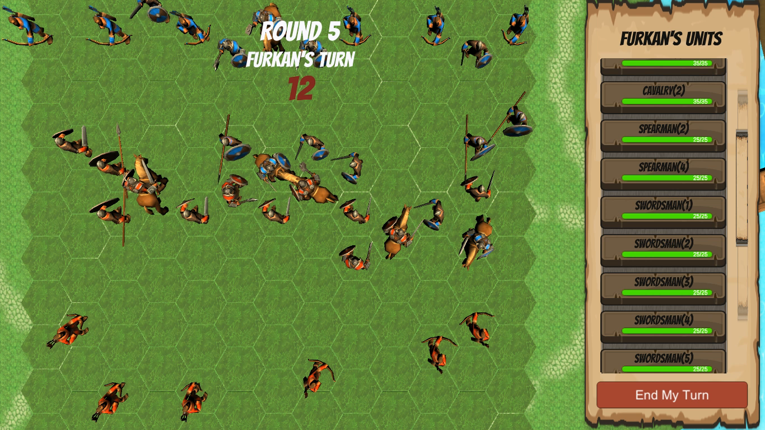
How it Works ?

Slide 8
Order of Action Phases
The actions below will take place in the given order for each turn.
If their priority is equal they will take place at the same time.
Offensive Player’s units will take action before Defensive player’s.
QA = Quick Attack , NA = Normal Attack , Mov = Movement

Slide 9
PHASE 1
Swordsman QA
Spearman QA
Cavalry QA
PHASE 3
Swordsman Mov
Spearman Mov
Archer Mov
PHASE 2
Archer QA
PHASE 5
Swordsman NA
Spearman NA
Cavalry NA
Warlord QA
King QA
PHASE 6
Warlord NA
King NA
PHASE 4
Warlord Mov
Cavalry Mov
King Mov
PHASE 7
Archer NA

Slide 10
Combat System
If a unit is attacked it can block the first attack each turn if it has a shield.
If no block lives are left unit takes damage.
If health points go below zero unit dies.
Some units can break the blocking immediately which lets them apply direct damage to health points of the enemy.

Slide 11
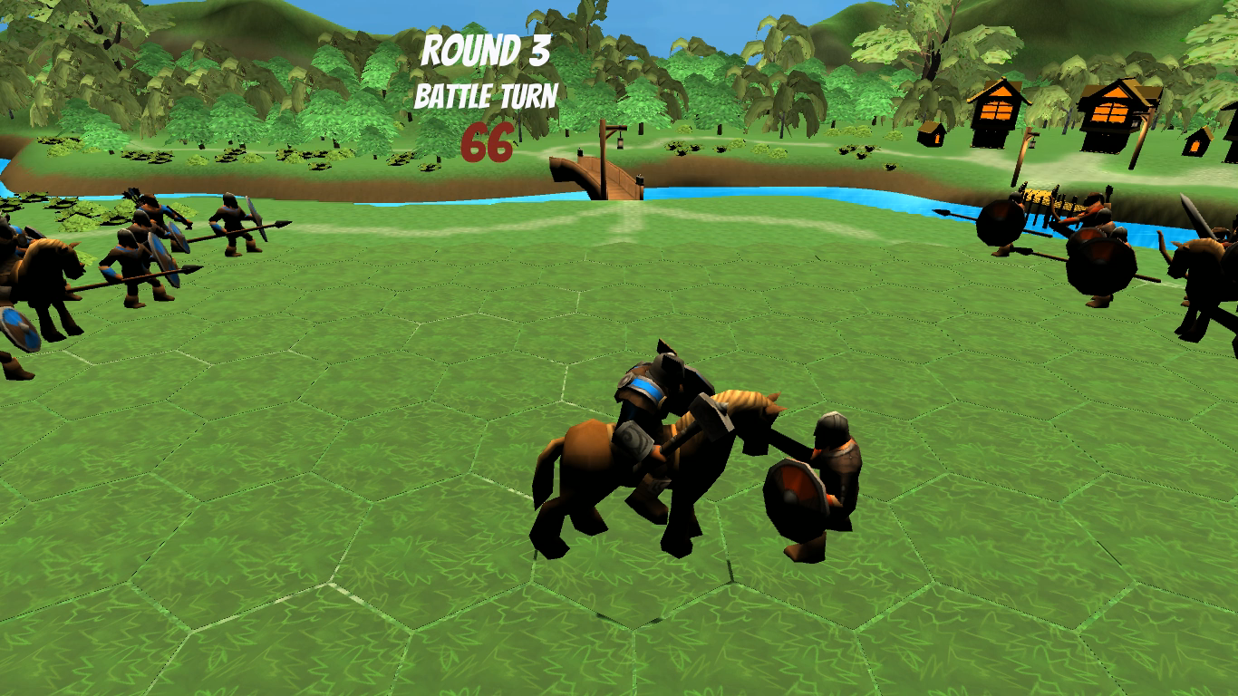
Blocking

Slide 12

Breaking Block and Death

Slide 13
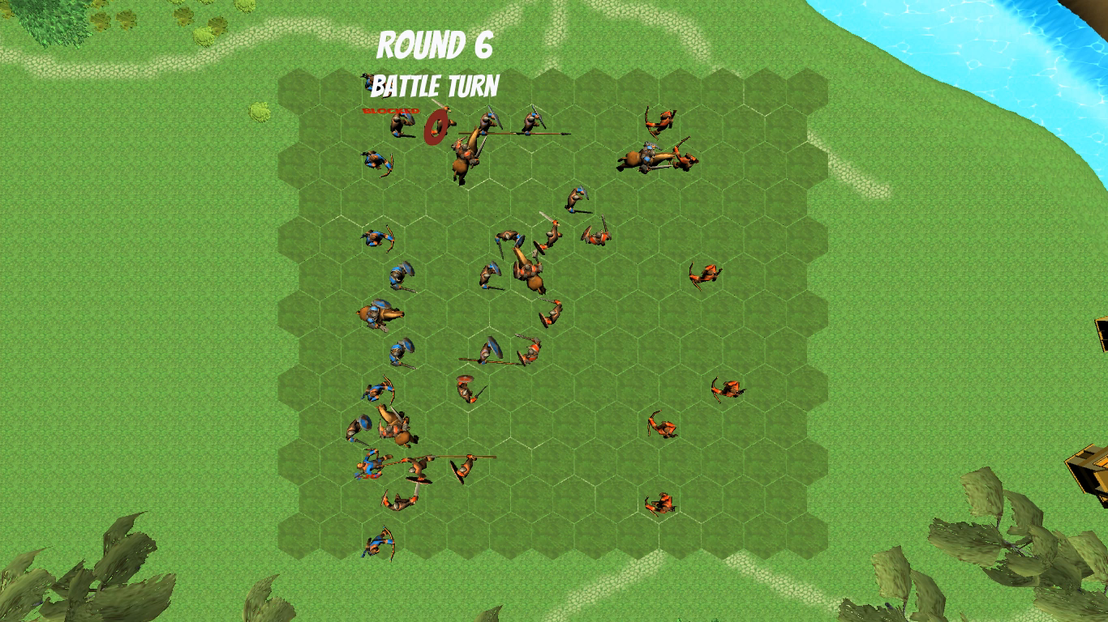
How a player wins ?

Slide 14
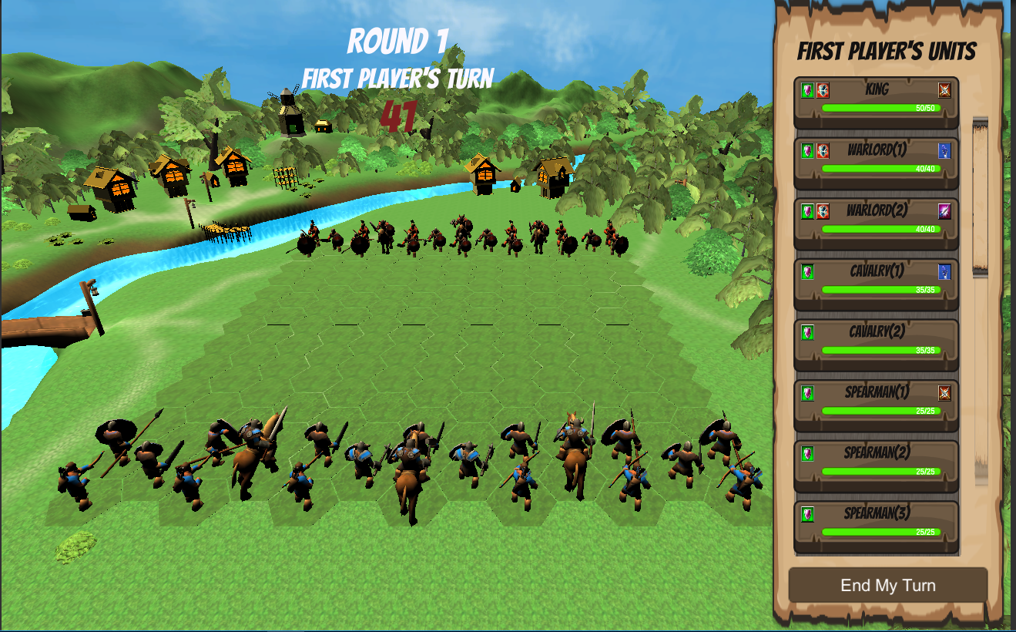

Slide 15
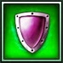
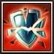
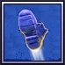
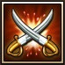
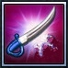
Label Icons
Indicates unit can block the first attack each turn.
Indicates unit can break through blocks.
Indicates unit choosed to move this turn.
Indicates unit choosed to Normal Attack this turn.
Indicates unit choosed to Quick Attack this turn.

Slide 16
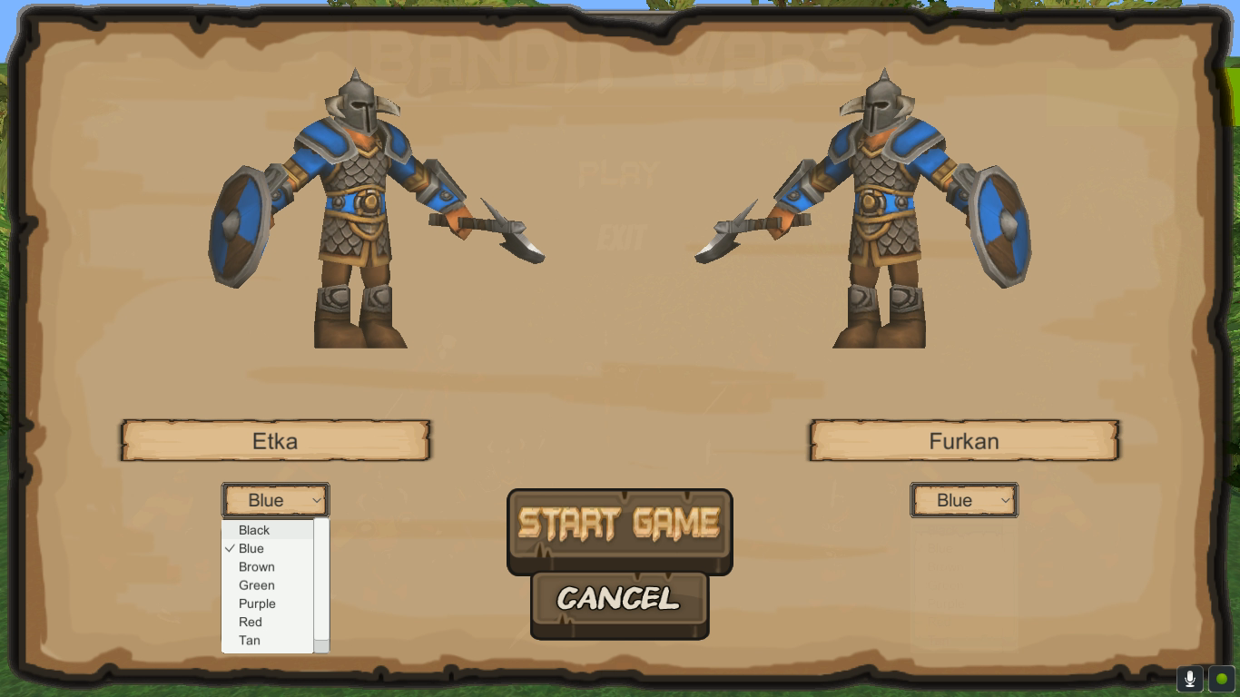
Changing Unit Colors

Slide 17
References
https://assetstore.unity.com/packages/3d/characters/toon-rts-units-barbarians-117277 - Unit Models
https://assetstore.unity.com/packages/3d/environments/fantasy/glowing-forest-79686 - Environment Models
https://assetstore.unity.com/packages/3d/environments/low-poly-pack-94605 - Environment Models
https://assetstore.unity.com/packages/2d/gui/fantasy-wooden-gui-free-103811 - GUI Sprites
https://assetstore.unity.com/packages/vfx/particles/cartoon-fx-free-109565 - Particle Effects

Slide 18
Halil Etka Tutkun Said Furkan Ayvaz Yavuz Baykut Kaya
Bandit Wars Developer Team

